Slide 1
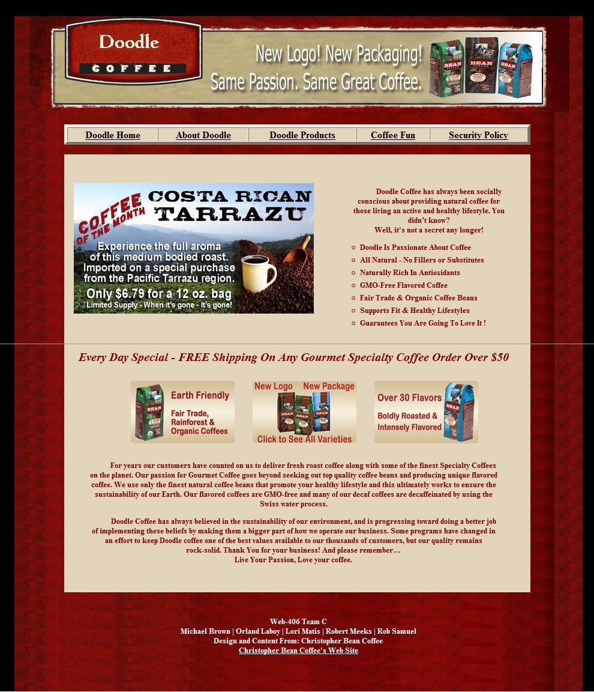
Doodle Home/Index Page
Home Page Features
JavaScript rotating banner
Basic menu built by a table and use of a herf links.
Css layout with separate css file page

Slide 2
Doodle Home/Index Page
Feature JavaScript Banner html
<script type="text/javascript">
adImages = new Array("header1.jpg","header2.jpg","header3.jpg")
thisAd = 0
imgCt = adImages.length
function rotate() {
if (document.images) {
thisAd++
if (thisAd == imgCt) {
thisAd = 0
}
document.adBanner.src=adImages[thisAd]
setTimeout("rotate()", 3 * 1000)
}
}
</script>
</head>
<body onload="rotate()">

Slide 3
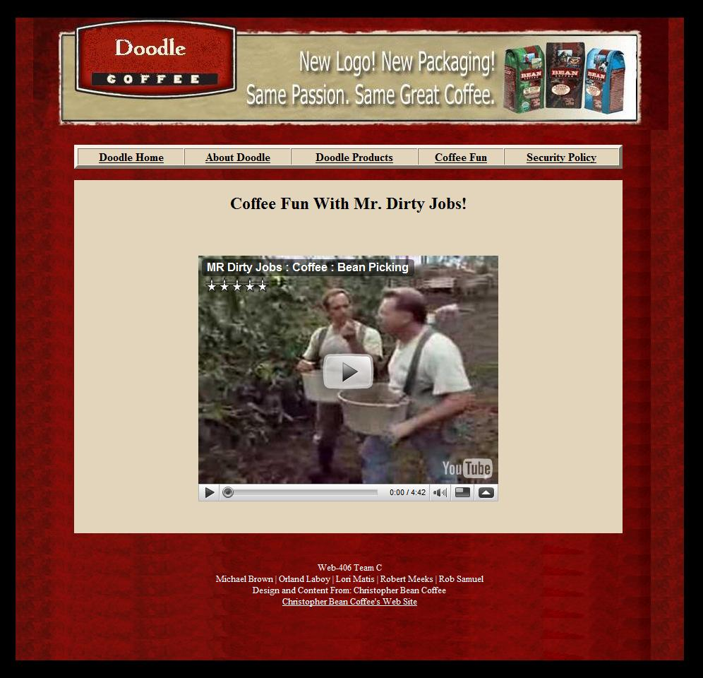
Doodle Coffee Fun Page
Coffee Fun Page Features
Embedded movie clip

Slide 4
Doodle Coffee Fun Page
Feature Embedded Movie html
<div id="body">
<h2>Coffee Fun With Mr. Dirty Jobs!</h2>
<br/>
<h2><object width="425" height="344"><param name="movie" value="http://www.youtube.com/v/6GG6xOn2mqI&hl=en&fs=1"></param><param name="allowFullScreen" value="true"></param><param name="allowscriptaccess" value="always"></param><embed src="http://www.youtube.com/v/6GG6xOn2mqI&hl=en&fs=1" type="application/x-shockwave-flash" allowscriptaccess="always" allowfullscreen="true" width="425" height="344"></embed></object></h2>
</div>

Slide 5
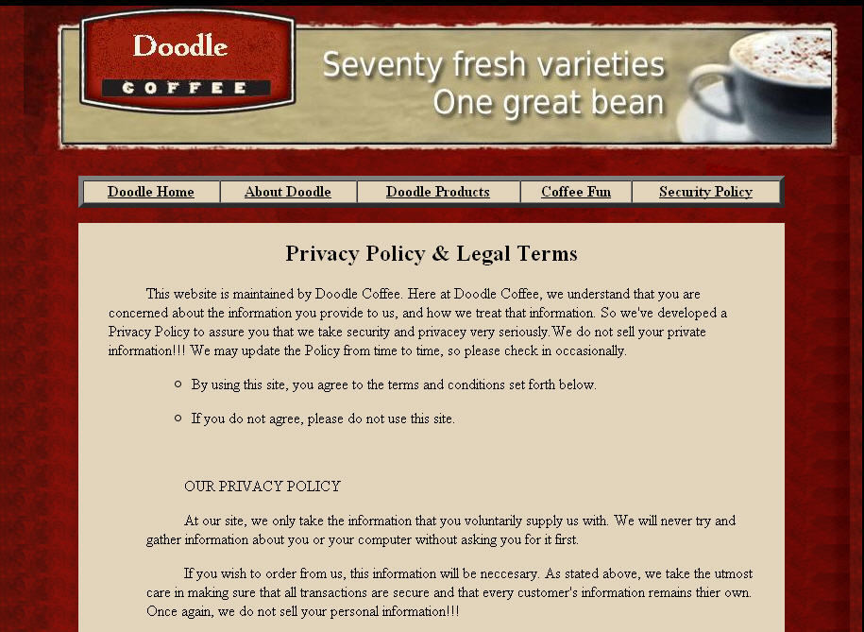
Doodle Coffee Privacy Policy
All information is kept confidential
All cookie data will not be sold
We do not record E-mail Addresses
All submitted forms will be encrypted through SSL

Slide 6
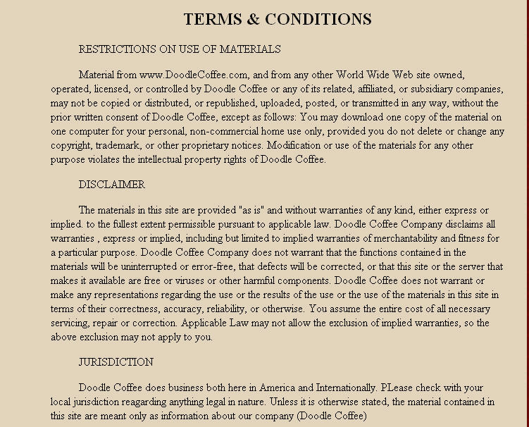
Doodle Coffee Terms and Conditions
Restrictions on use
Virus and malware disclaimer
Legal Jurisdiction
Termination of Terms and Conditions
Misc. notes on other Terms and Conditions

